Slide 1
生成式AI技術與數位行銷人才養成班 人工智慧概論
謝欽旭
國立高雄科技大學電子工程系
2025

Slide 2
CLASSICAL ARTIFICIAL INTELLIGENCE
From the 1950s to the 1990s, the dominant paradigm in Al research was classical (or "symbolic" or "logical") Al.
This approach to Al was based on logical reasoning, using symbols and rules—written by human programmers—to represent concepts and the relationships between them.
Classical Al had many successes, including Als that could play games, hold basic conversations, and answer queries using “expert systems.”
Although statistical Al has since overtaken classical Al the old approach has not been entirely abandoned; many of its techniques have been incorporated into modern Al applications, such as natural language processing and robotics.

Slide 3
REPRESENTING DATA - SYMBOLS IN Al
In Al, a “symbol” is a graphical representation of a real-world item or concept.
In classical Al, symbols embody the total sum of the relevant facts and information required for the system to understand what something is.

Slide 4
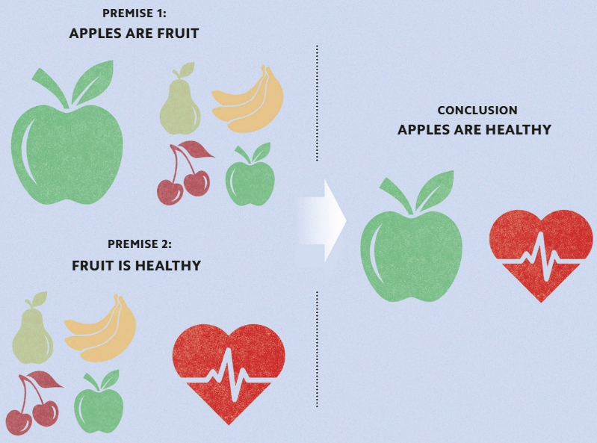
FOLLOWING THE RULES - COMPUTER LOGIC
Logic is the study of sound reasoning, and of the rules that determine what makes an argument valid.
In practice, logic enables people to take statements about the world (known as premises) and derive new information from those statements (known as conclusions).
Als are programmed to follow strictly logical rules, with the aim of producing reliable conclusions.

Slide 5
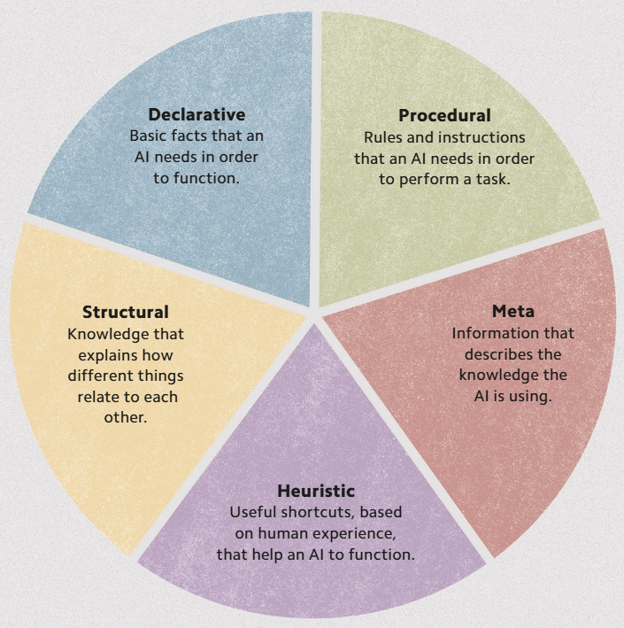
WHAT, WHEN, WHY, AND HOW? - KINDS OF KNOWLEDGE
Al systems use up to five kinds of knowledge in their interactions with the world but only two are common to all Als.
Declarative knowledge is the most basic form and describes statements of fact, such as "cats are mammals," whereas procedural knowledge instructs Als how to complete specific tasks.

Slide 6
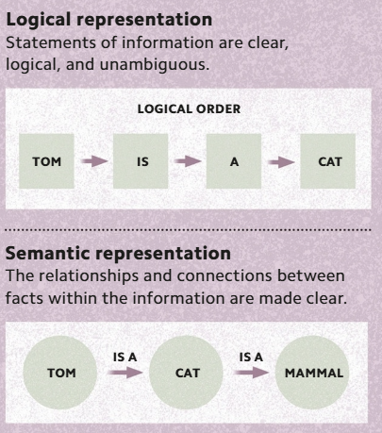
PRESENTING KNOWLEDGE - KNOWLEDGE REPRESENTATION
In order for an Al to understand information correctly, the information must be presented to it very clearly.
“Logical representation” poses information using the exact words of a natural language (or symbols to represent them).
“Semantic representation” ensures that the individual meanings within the information are connected in a formal, logical way.

Slide 7
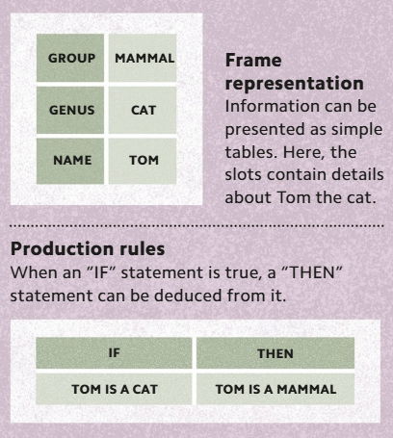
PRESENTING KNOWLEDGE - KNOWLEDGE REPRESENTATION
“Frame representation” involves presenting the information in a tabular format, with facts allocated to individual "slots."
“Production rules” are the instructions that state what conclusions an Al can deduce from the information it is supplied with.

Slide 8
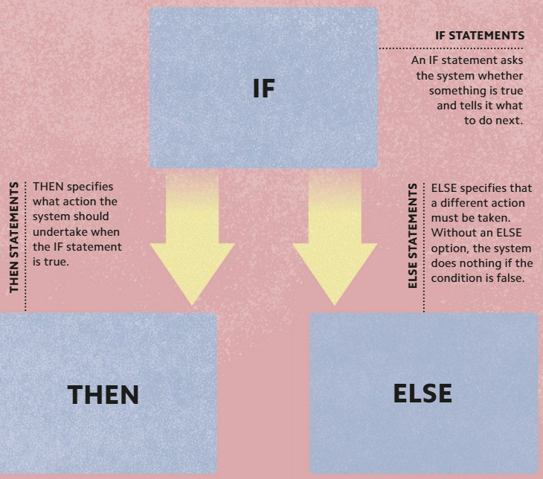
IF THIS, THEN THAT - RULES
A rule-based Al system uses instructions, consisting of "IF-THEN“ statements, to draw conclusions based on an initial set of facts.
Rule-based systems are predictable, reliable, and “:transparent,” meaning it is easy to see which rules the Al applies.
However, rule-based Als cannot “learn” by adding to their store of rules and facts without human intervention.

Slide 9
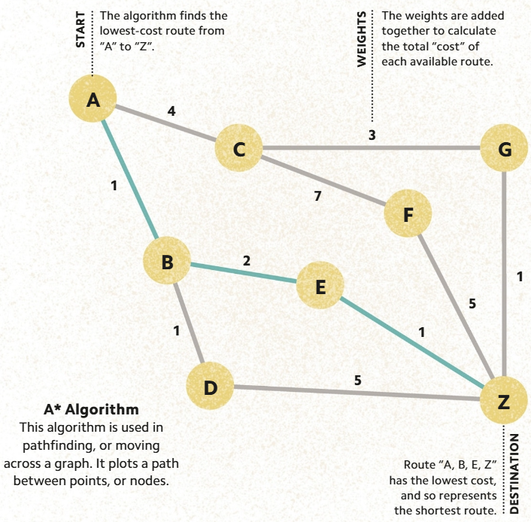
THE SHORTEST ROUTE - PATHFINDING
Pathfinding algorithms are search algorithms that are used to find the shortest route between two points.
The algorithm is programmed using a weighted that shows all of the possible paths available.
The algorithm calculates the weights to find the shortest path.

Slide 10
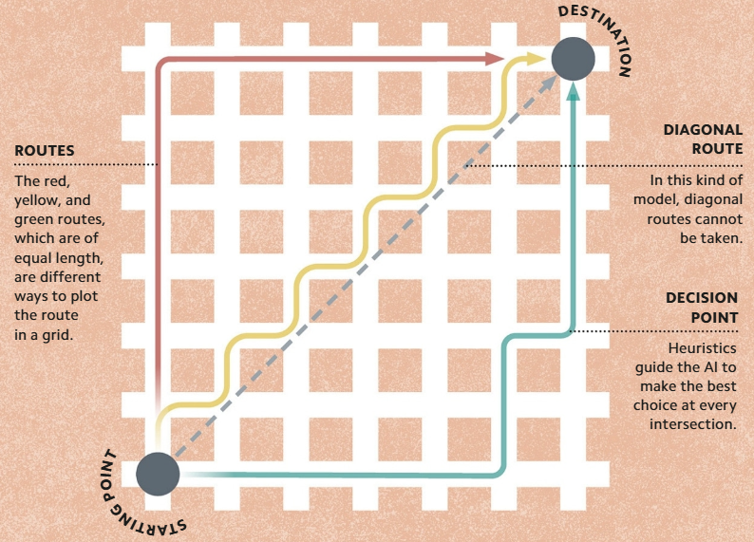
IMPERFECT SOLUTIONS - HEURISTICS
Some problems can be too complex for an algorithm to solve quickly.
In such cases, an Al can do a "brute-force search," which means to methodically work through and evaluate every possible solution. This is slow, however and in some cases impossible.
A more efficient alternative is to use a "heuristic." This practical method uses a common-sense approach, searching for an approximate solution by estimating a "good enough" choice at every decision point based on the information available.

Slide 11
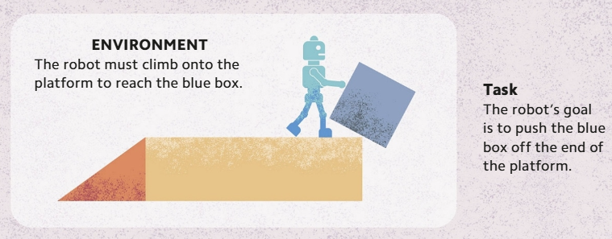
PERFORMING A TASK - PLANNING AND Al
Embodied Als, such as robots, use a technique known as "planning" to help them solve practical problems.
Planning involves understanding the environment or location in which the task must be performed and mapping out the actions required to complete it.
The Al must identify each step required to fulfill the task and the optimal—lowest cost—sequence in which to perform them.

Slide 12
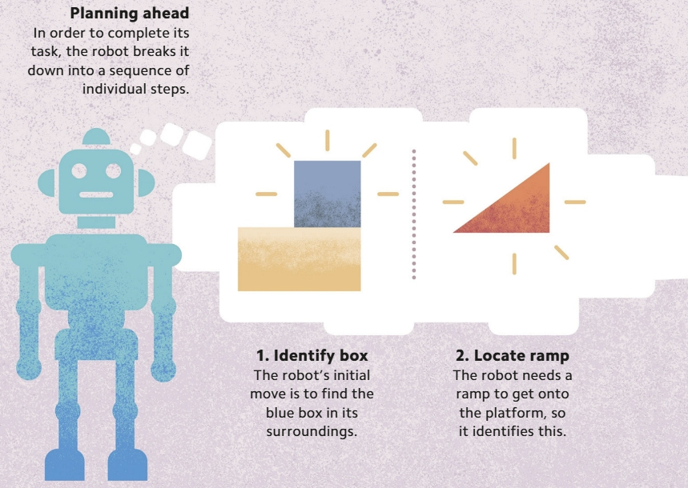
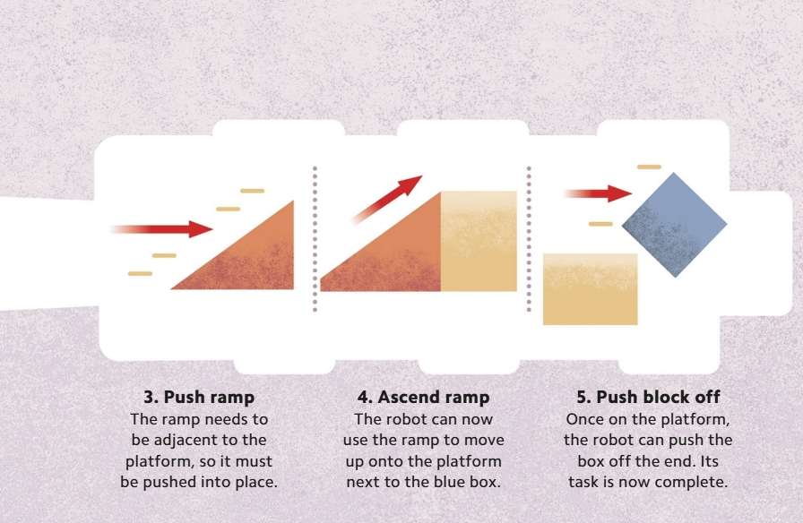
PERFORMING A TASK - PLANNING AND Al

Slide 13
DEALING WITH UNCERTAINTY - PROBABILITY AND Al
Uncertainty is an unavoidable feature of life, and it can be incorporated into Als using the concept of probability.
Probability is a numerical value of how likely something is to occur.
"Probabilistic reasoning" is any method of reasoning that takes probability into account.
Bayes‘ theorem calculates the likelihood of an event happening.
Instead of figuring out the probability of the event in isolation, Bayes' theorem bases probability on prior knowledge of the relevant conditions.

Slide 14
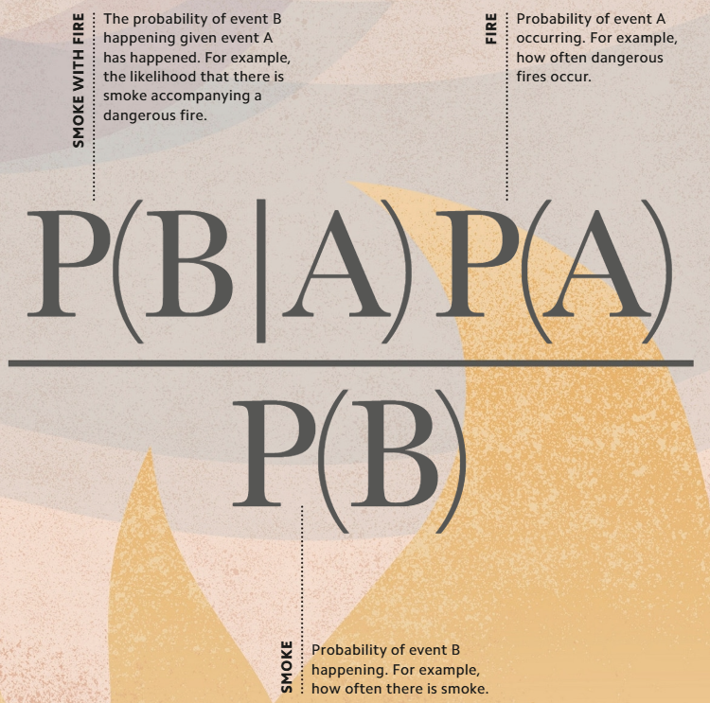
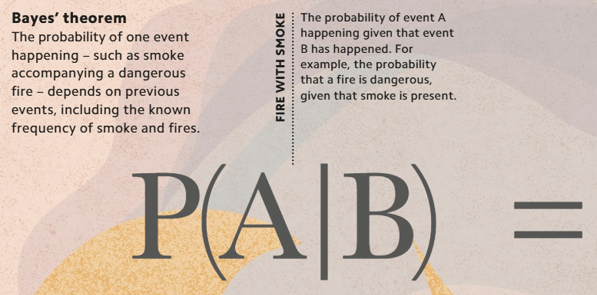
DEALING WITH UNCERTAINTY - PROBABILITY AND Al

Slide 15
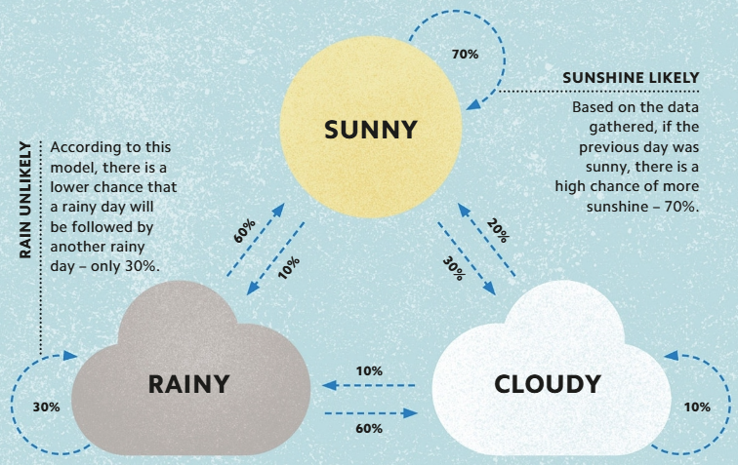
MODELING CHANGES - THE MARKOV CHAIN
A Markov chain is a model that describes a sequence of possible events in which the probability of each event depends on the state that was reached in the previous event.

Slide 16
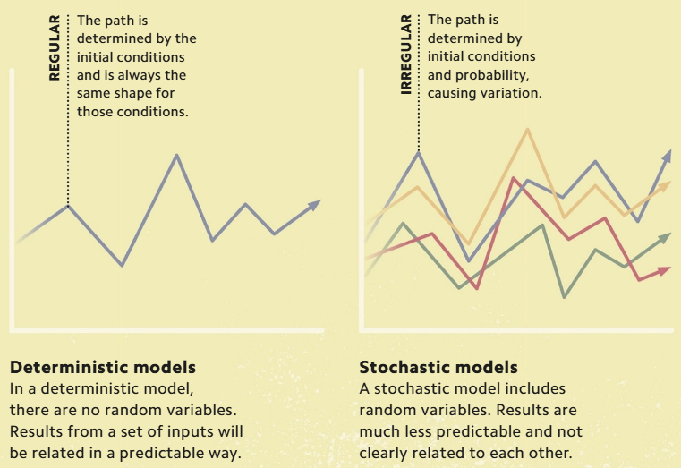
MODELING UNCERTAINTY - STOCHASTIC MODELS
Stochastic models enable Als to make predictions about processes and situations that are affected by chance events.
The volatile and ever-changing factors in these scenarios are represented by random variables.

Slide 17
AUTOMATED ADVICE - EXPERT SYSTEMS
Computer programs that replicate the knowledge and reasoning skills of human specialists are known as "expert systems."
The information that they contain is supplied by human experts, and is programmed into the system by a "knowledge engineer."
Each system has three parts.
The “knowledge base” contains the facts and rules used by human experts on the topic.
The “inference engine” applies the rules to the facts in the knowledge base to deduce answers to queries posed by users.
The “user interface” accepts queries from users and displays solutions found bv the system.

Slide 18
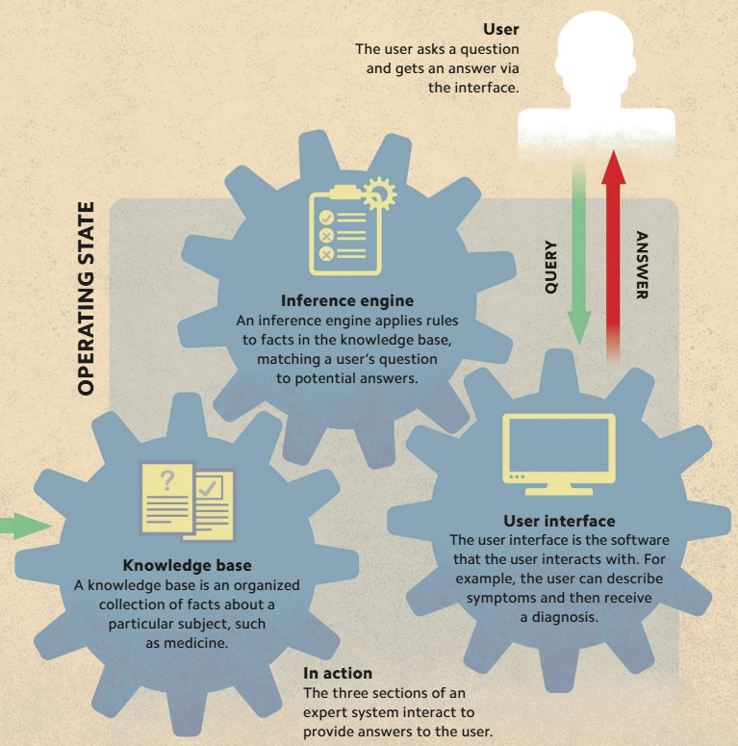
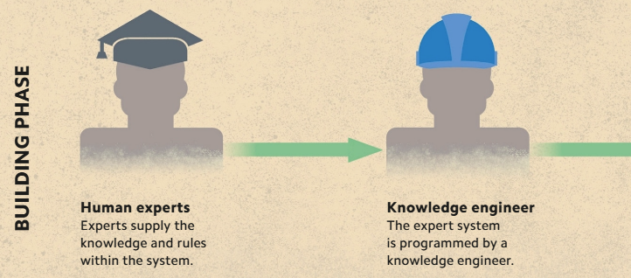
AUTOMATED ADVICE - EXPERT SYSTEMS

Slide 19
HANDLING "MESSY" DATA - MESSINESS
Classical Als struggle with some tasks that humans find simple.
We can program computers for reasoning-based tasks, such as playing chess, but not for sensorimotor- and perception based tasks such as catching a ball or recognizing a cat.
The Austrian-Canadian programmer Hans Moravec (1948-) argued that reasoning tasks are easy to teach to computers because humans have already figured out the steps that are required to complete them.
In contrast, sensorimotor and perception activities involve unstructured, or "messy," data that requires a lot of processing.
For humans, these tasks are largely unconscious actions, refined over millions of years of brain evolution, but they are difficult to break down into a series of steps that a computer can follow.

Slide 20
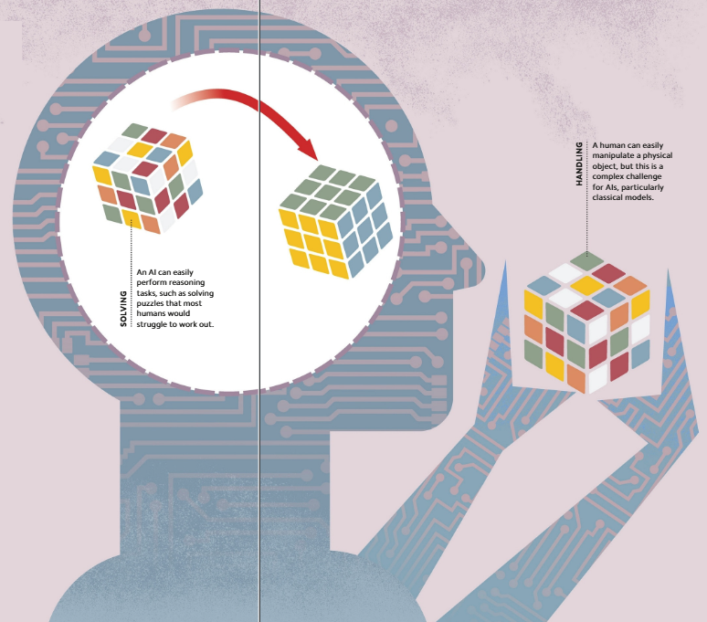
HANDLING "MESSY" DATA - MESSINESS

